Slide 1


The Green Link
An ethical analysis of LinkNYC kiosk usage and energy consumption
By Rolando Mancilla-Rojas
And Kabbo Sultan

Slide 2
How can LinkNYC optimize kiosk service and usage distribution across boroughs while minimizing energy waste?

Slide 3

Table of Contents
01
02
03
04
↓
EDA, KPIs, Features
Funnel
Analysis
Cohort &
Retention
Recommendations

Slide 4

But first,
Some Context…
↓

Slide 5

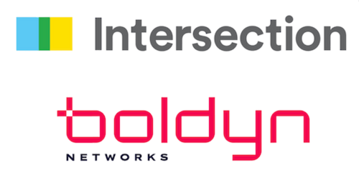
Our Stakeholder:
Based in New York City, Our stakeholders consist of two companies:
Intersection, a media technology firm.
Boldyn Networks a network infrastructure company.
Together, they formed a consortium named CityBridge that has a emphasized focus on reducing carbon footprint.

Slide 6
Two Main Data Sources
Kiosk Usage
Kiosk Location
LinkNYC
LinkNYC
Geocoded Locations, Install/Activation
Weekly users, Sessions, Data Transfer

Slide 7
01
Exploratory Data Analysis, KPIs, Features

Slide 8
Inside the Data!
Usage Trends & Patterns
Seasonality is a major factor:
Strong: Winter months
(Jan-March)
Weak: Spring
(April)
Geographic Patterns
Kiosk distribution is uneven;
Manhattan has the highest,
Bronx/Staten Island the lowest
Feature Engineering
Activation Time
Kiosk Age
Weekly Session Change (%)
Average Session Time (Mins)
Energy Efficiency
Energy Efficiency Rating Flag
→
→
→

Slide 9
KPIs
170
Days
2636 Days
0.033
Rating
Average Time For Deployment
Installation → Activation
Average Age of
Kiosks
Roughly 7 Years
Average Energy Efficiency
Dimensionless ;
“Fair” Energy Consumption

Slide 10

02
Funnel Analysis

Slide 11
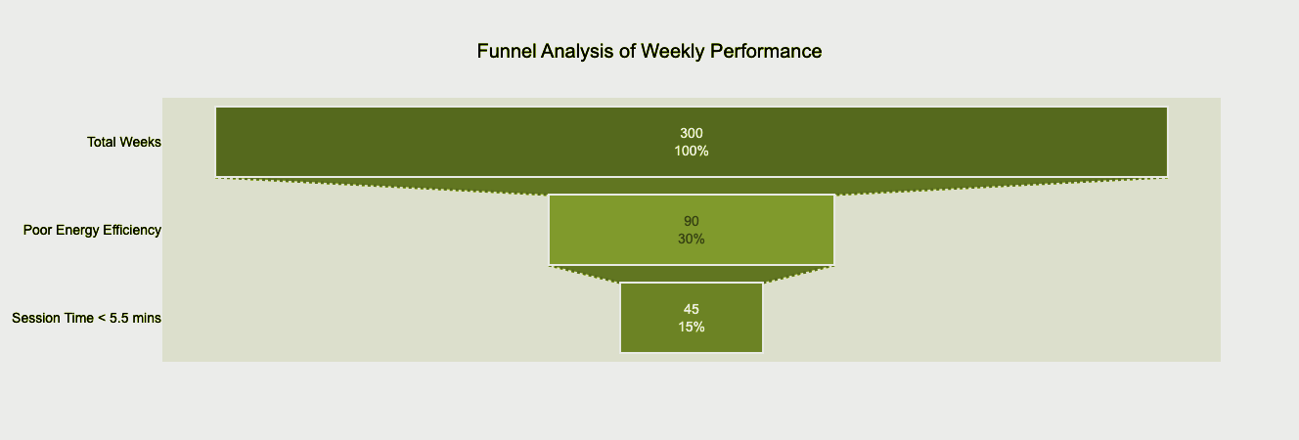
50% of “Poor” Weeks → Short Sessions
Total Weeks
300 Weeks,
Entire Usage Dataset
Poor Energy
90 Weeks,
<30% Energy Efficiency Rating
Short Sessions
45 Weeks,
Below 5.5 min Avg. Sessions

Slide 12
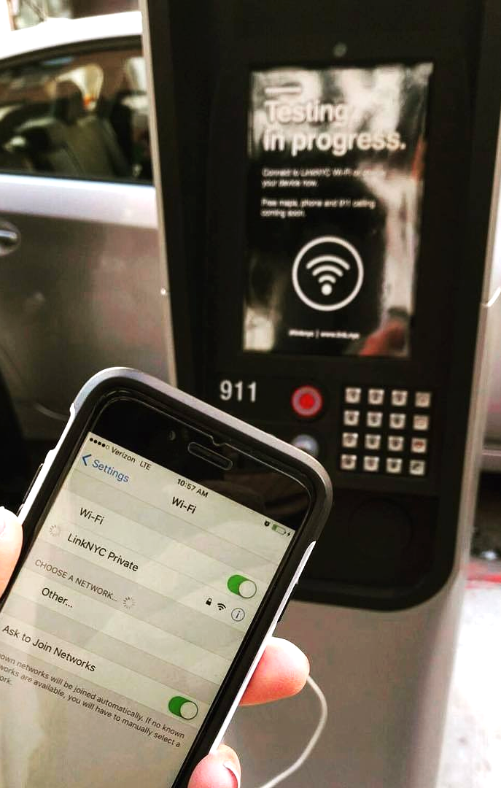
But What Does This Mean?
A Real-World Example…
Notes:
Imagine you are a tourist visiting NYC, and need to connect to the internet in order to call an Uber ride. You don’t speak much English, but luckily, you find a kiosk that can translate into your language. You load up the kiosk, connect to the wifi, and call an Uber. Within 5 minutes, you have already left the kiosk and are on your way back to the hotel.
Scenarios like these are undoubtedly common in Manhattan, the most tourist-heavy borough with the highest number of LinkNYC kiosks. It is scenarios like these that are contributing to the highest energy consumption costs across the grid.
NYC is the fastest city on Earth. Fast kiosk transactions aren’t just expected; they’re inevitable. The energy consumption of these fast transactions is too high a cost to continue operating this way.

Slide 13

03
Cohort & Retention

Slide 14
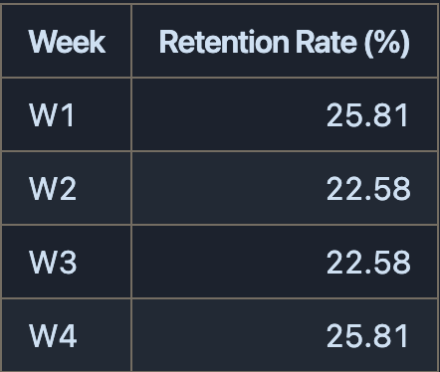
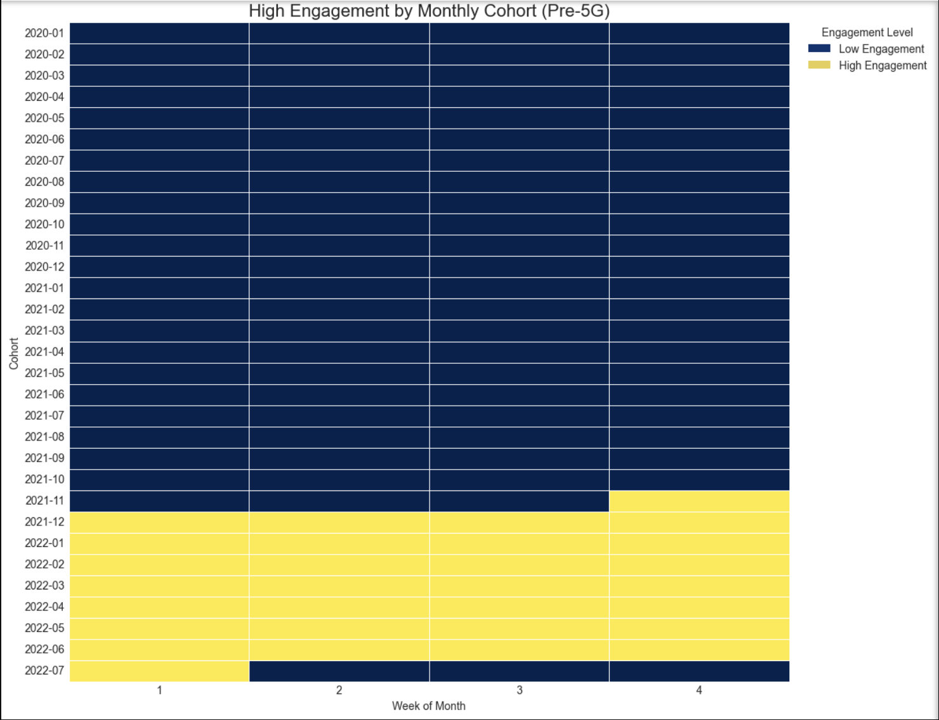
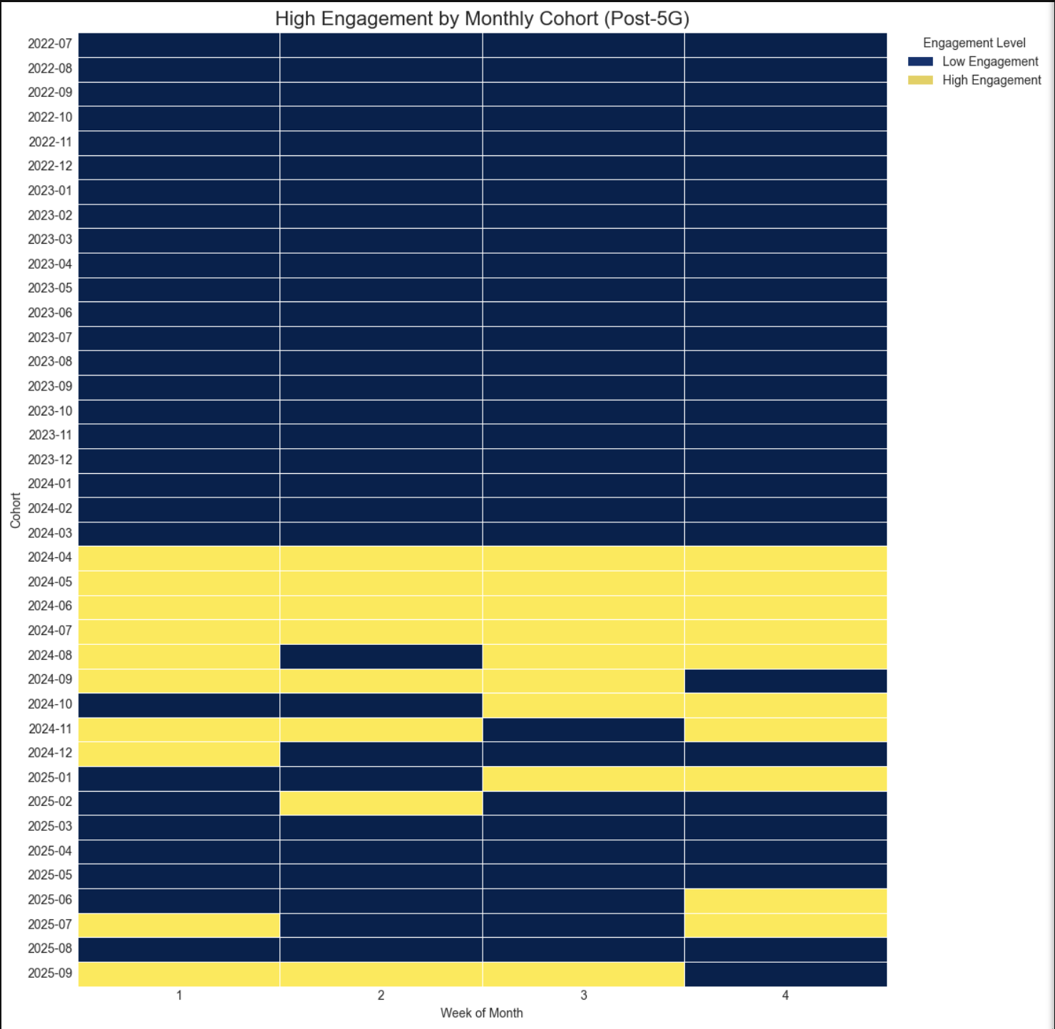
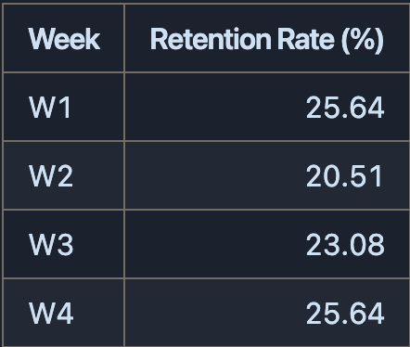
Cohort & Retention
Pre - 5G Retention Rates
Pre - 5G
Post - 5G
High engagement weeks follow a predictable pattern.
User engagement becomes sporadic.
Post - 5G Retention Rates
Blue means low engagement.
Yellow means high engagement.
Notes:
Our data consistently shows a dip in user engagement during the second week of every month in the post-5G era. While the first and fourth weeks remain periods of high engagement, this "Week 2 Slump" is a new, predictable pattern that we can leverage.
We propose a two-pronged strategy to address this, depending on the immediate business goal:
For Operational Efficiency & Cost Savings:
Action: Designate the second week of each month as the primary window for scheduled network maintenance, software updates, and physical kiosk servicing.
For Engagement Growth & Marketing:
Action: Target the second week of each month for specific user re-engagement campaigns.

Slide 15

04
Recommendations
& What’s Next

Slide 16
Recommendations
Configure System Software | Dedicate the Maintenance & Deployment teams to (re)configure the kiosks. Set kiosks to sleep during off-use rather than completely shutting down.
Alternative Energy Sources | Longer term, implement a solar panel system that absorb the heat from the sun and powers the kiosks.
Operational Efficiency | Designate the second week of each month as the primary window for scheduled network maintenance, software updates, and physical kiosk servicing.
Engagement Growth | Target the Spring months for specific user re-engagement campaigns.
Equity | Implement a dual maintenance strategy: a primary, data-driven plan for high-density areas, supplemented by a secondary, equity-focused plan that guarantees a baseline level of service and uptime for all kiosks.
Notes:
Our analysis yielded two main strategic insights and actionable recommendations for LinkNYC:
"Week 2 Slump": Operational Pattern
Insight: User engagement consistently dips in the second week each month post-5G rollout.
Recommendation: Use this slump for maintenance or re-engagement campaigns.
Tiered Strategy for Energy Efficiency
Insight: We categorized historical weeks into "Poor," "Fair," "Good," and "Excellent" based on a custom energy efficiency metric.
Recommendation: Implement a tiered ROI strategy: replicate "Excellent," optimize "Good," and investigate "Fair/Poor" weeks.
Finally, somes ethics & equity considerations
Insight: LinkNYC kiosks are concentrated in Manhattan, causing a digital divide.
Recommendation: Implement a dual maintenance strategy: data-driven in high-density areas, and equity-focused for underserved boroughs.

Slide 17
What’s Next?
More to Explore:
We would like to see why post-5G engagement has become more sporadic.
Why engagement dips in week 2 and the month of April.
Energy data (kWh) for a better approximation of energy consumption.

Slide 18

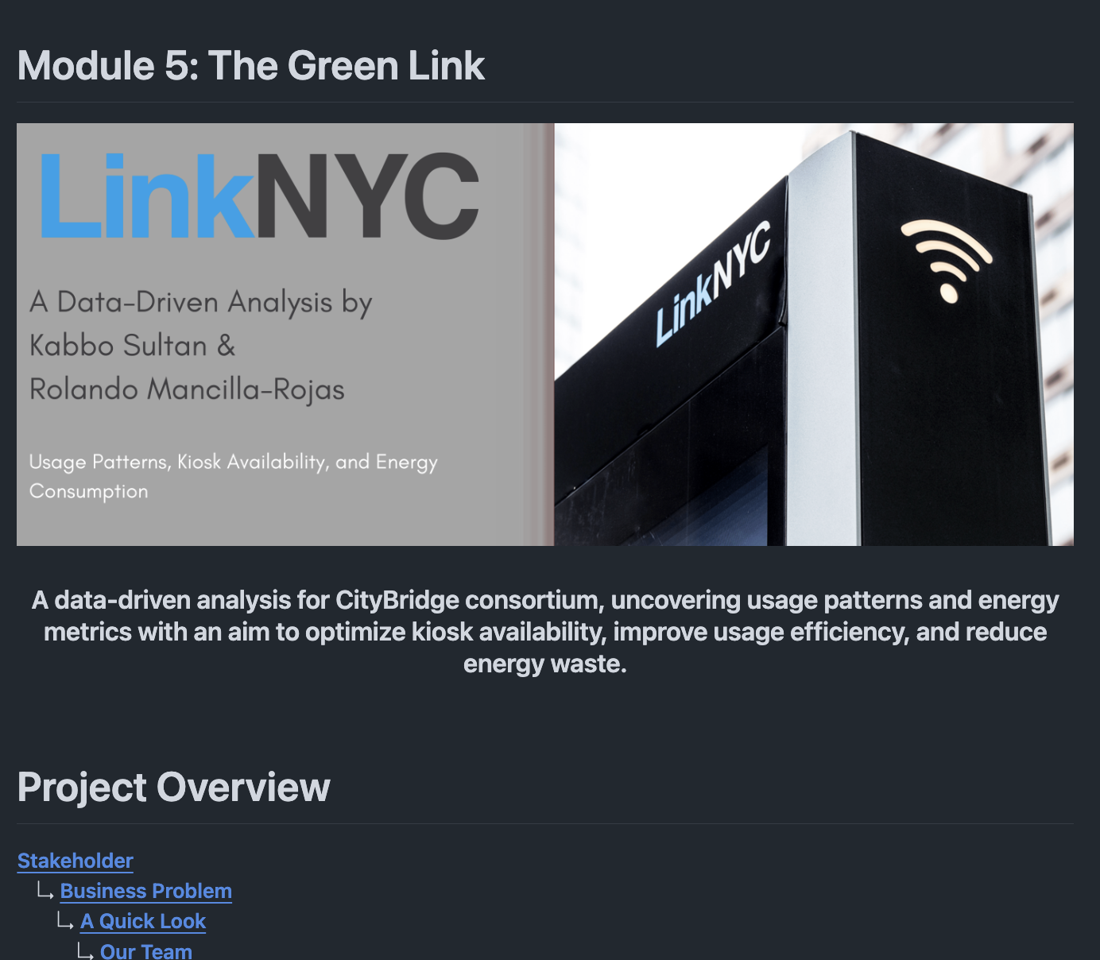


Thanks!
Rolando Mancilla-Rojas
Connect With Me!
Kabbo Sultan
Connect With Me!
github.com/repo

